Slide 1
Diabetes Prediction
Laawanyaa Sai Thota(002208176)

Slide 2
What is diabetes?

Slide 3
Diabetes is a chronic (long-lasting) health condition that affects how your body turns food into energy.
Your body breaks down most of the food you eat into sugar (glucose) and releases it into your bloodstream. When your blood sugar goes up, it signals your pancreas to release insulin. Insulin acts like a key to let the blood sugar into your body’s cells for use as energy.
With diabetes, your body doesn’t make enough insulin or can’t use it as well as it should. When there isn’t enough insulin or cells stop responding to insulin, too much blood sugar stays in your bloodstream. Over time, that can cause serious health problems, such as heart disease, vision loss, and kidney disease

Slide 4
Problem definition

Slide 5
There isn’t a cure yet for diabetes, but detecting it in early stage and taking proper medication and diet helps in keeping it under control
The intention of this project is to build supervised models like Logistic regression, K nearest neighbors, Random Forest and Decision trees and identifying the best algorithm which can predict diabetes for a patient with high accuracy.

Slide 6
Data Source

Slide 7
The dataset for this project is obtained from center for disease control and prevention (CDC) website
National center for health statistics(NCHS), as a part of National health and nutrition examination survey has submitted the dataset to CDC
The link to dataset is here

Slide 8
Data description

Slide 9
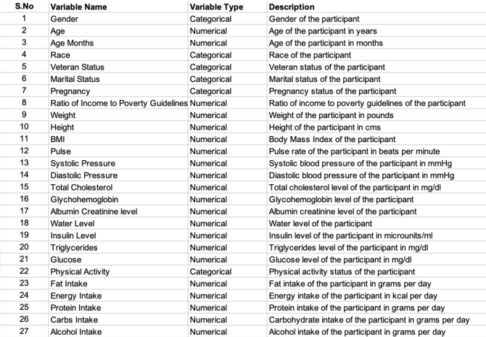

Slide 10
Data pre-processing

Slide 11
Pregnancy Column
Pregnancy attribute had around 80% null values
This is mainly because pregnancy is observed only in females (age group of 20-44)
All the null values are for males or females not falling in 20-44 age group bucket
So, imputed ‘2’ (not pregnant) for all the missing data in that column

Slide 12
Marital Status Column
Marital status is null for age groups below 19
This is mainly because age group below 19 are not allowed to marry without parents consent
So, imputed ‘5’ (never married) for all the missing data in that column

Slide 13
Other pre-processing steps
Remaining columns with less than 75% missing values were analyzed and imputed based on criteria such as age and marital status
Numerical columns with null values were imputed by grouping records with age and calculating the mean
After data cleaning, 6643 instances and 26 attributes were retained for further data mining steps

Slide 14
Exploratory Data Analysis

Slide 15
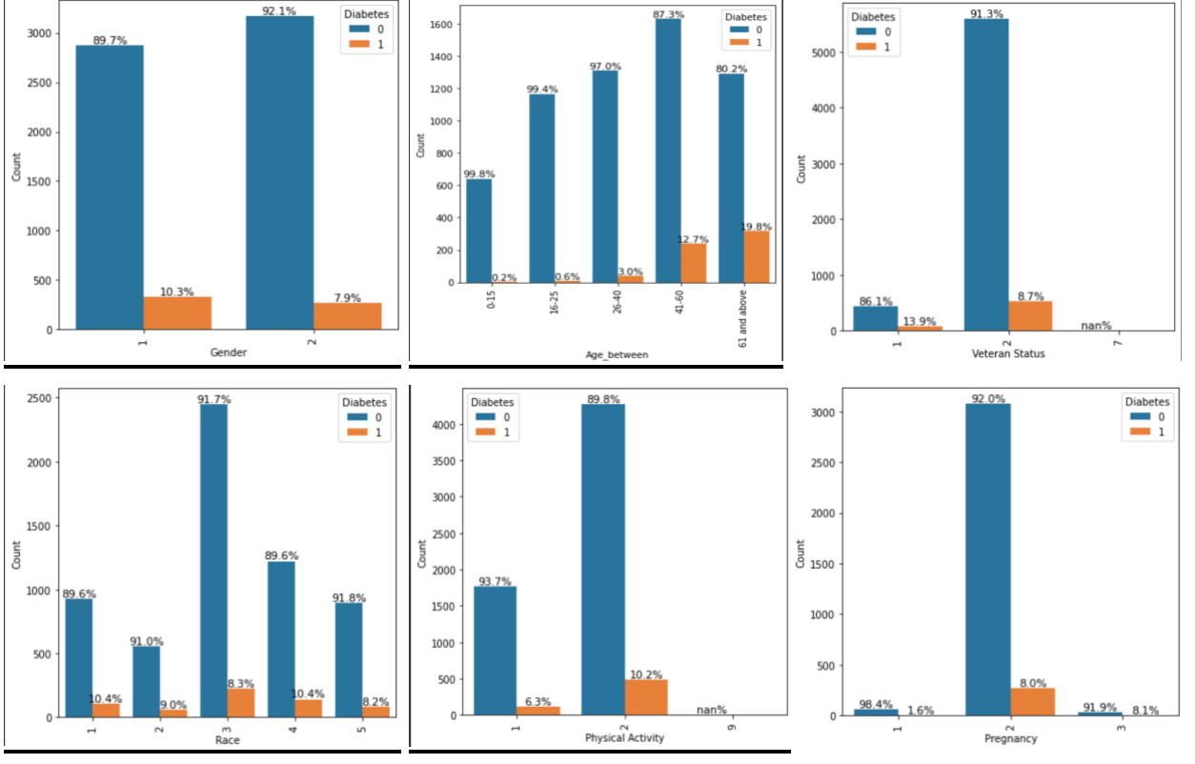
Categorical Variables
It is evident from the graphs that the target variable ‘Diabetes’ had more number of instances as 0 (Negative) compared to 1 (Positive). Considering the attribute Gender, the percentage of males with diabetes is more compared to females. Similarly, the count of Diabetes patients keeps increasing with age. Considering Physical activity and Veteran status, it can be inferred that veterans and people involved in physical activity and exercise may have a lower risk of diabetes

Slide 16
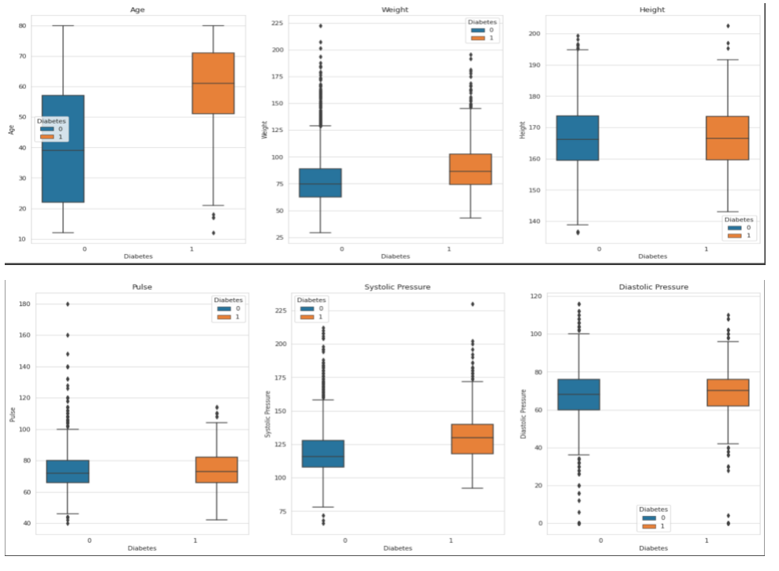
Numerical Variables
In the bivariate exploratory data analysis of numeric variables, it was observed that out of 6 variables, 5 variables had a significant number of outliers. The analysis showed that with increase in age, chances of getting Diabetes is also getting higher. Similarly, considering weight and systolic pressure, the median of the box plot for category 1 (those with diabetes) is higher than the median for category 0 (those without diabetes). We can infer that, on average, individuals with diabetes have higher weight and high systolic pressure than those without diabetes. This difference in medians suggests that there may be a relationship between diabetes and weight

Slide 17
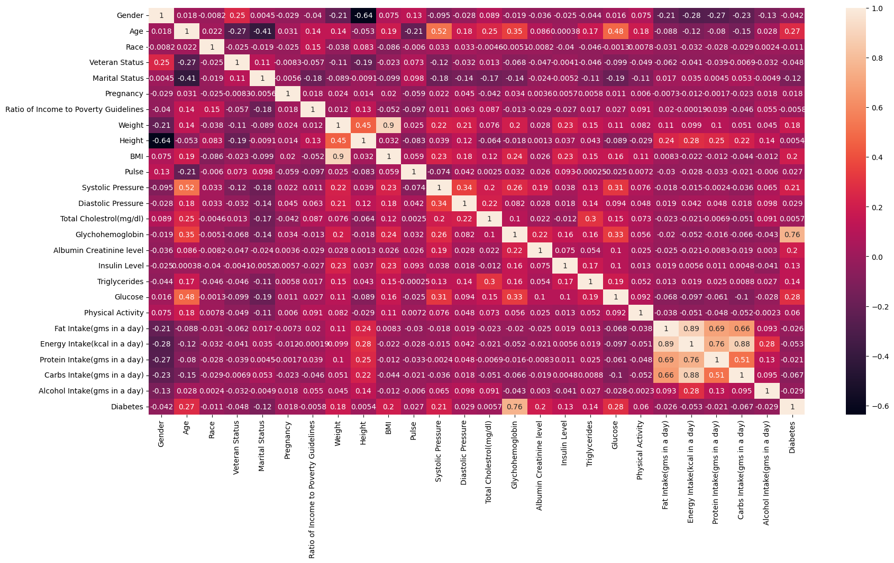
Correlation analysis
With the heatmap, it is evident that fat, carbohydrates, energy, and protein intake are heavily correlated
Also, Glucose level, Age, and Systolic pressure are positively correlated

Slide 18
Data MINING TASKS

Slide 19
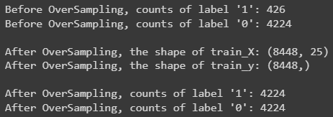
Data Partitioning and Balancing Data using SMOTE
Holdout Method was used with a 70:30 ratio to split the data into training and testing sets
Training set (X_train and y_train) with 4650 records was used for model training, while testing set (X_test and y_test) with 1993 records was used for model evaluation
The original data set had an imbalanced distribution with few data points labeled as "1" (diabetes) and majority labeled as "0" (non-diabetes)
SMOTE over-sampling technique was applied to the training data to address class imbalance, resulting in equal distribution of minority and majority classes with 4,228 data points each.

Slide 20
DIMENSIONALITY REDUCTION

Slide 21
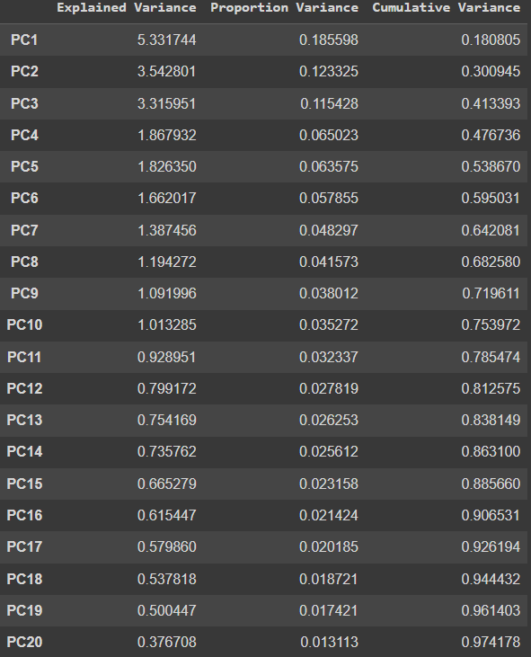
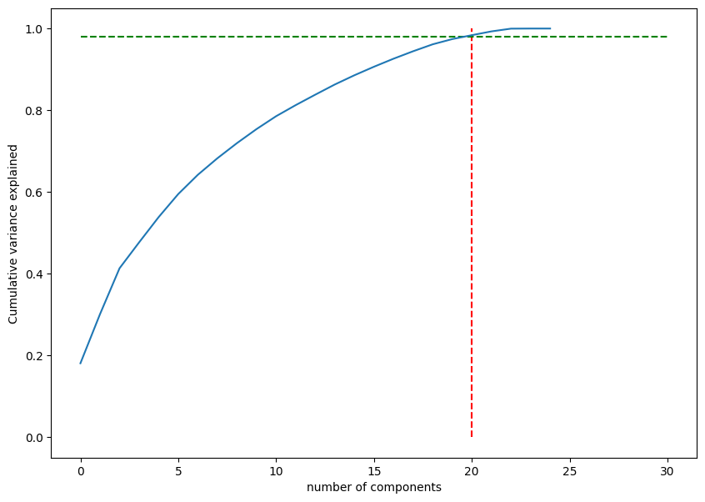
Principal component analysis

Slide 22
Models

Slide 23
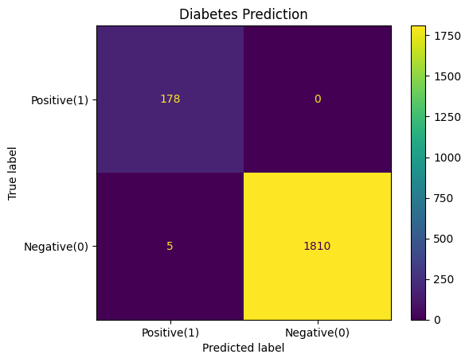
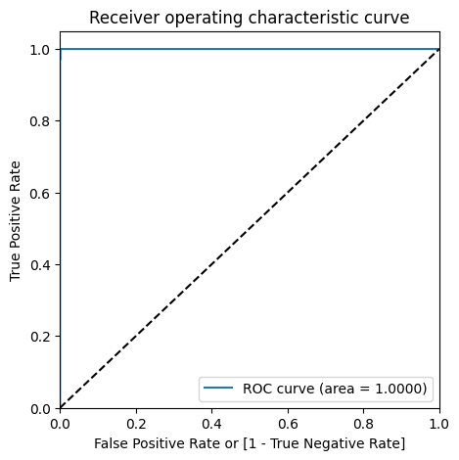
Logistic Regression

Slide 24
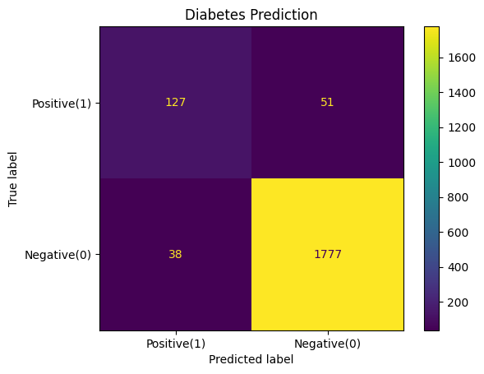
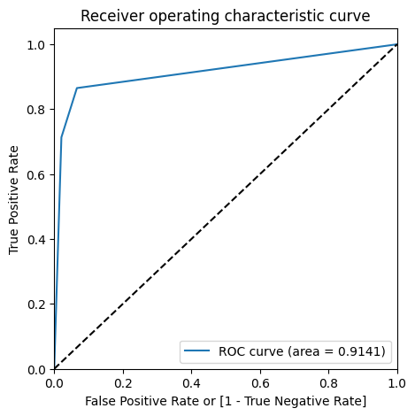

KNN Classifier

Slide 25
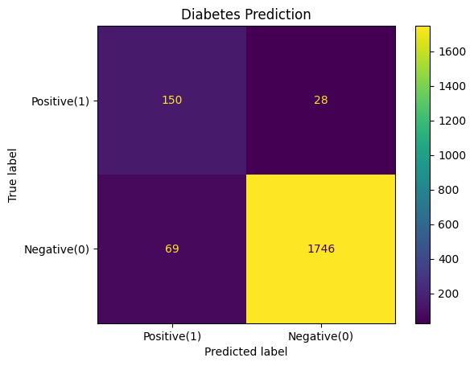
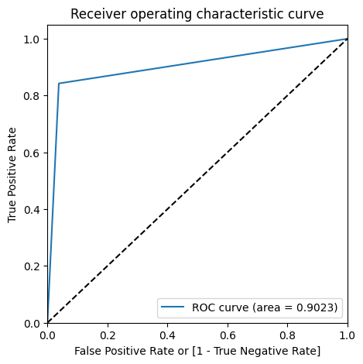

Decision Trees

Slide 26
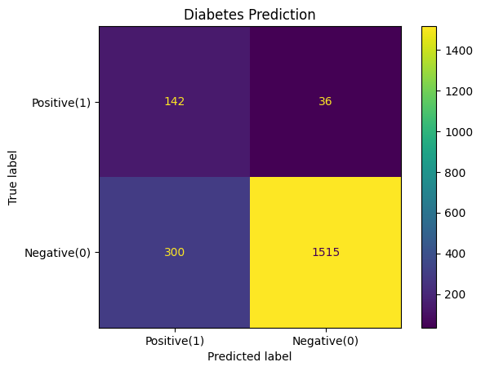
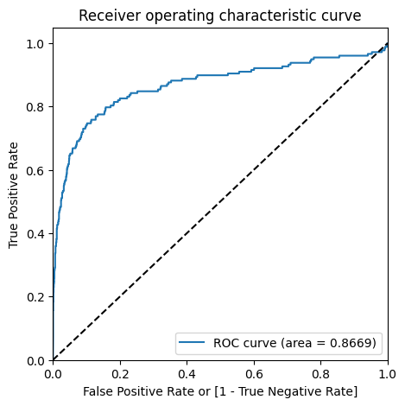

Naïve Bayes Classifier

Slide 27
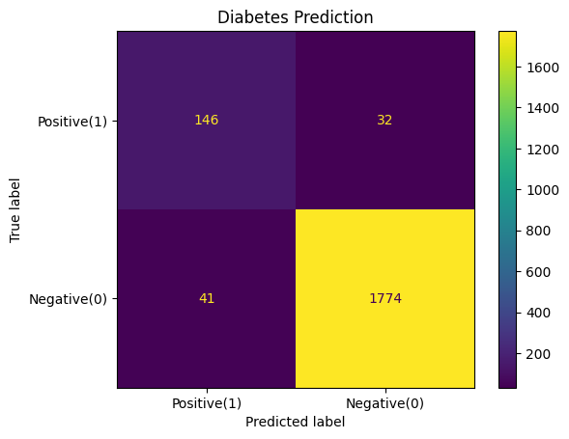
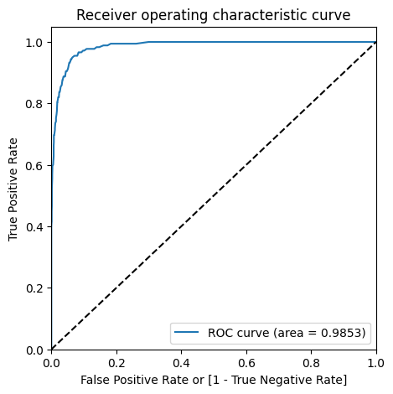

Random Forest

Slide 28
COMPARISON

Slide 29
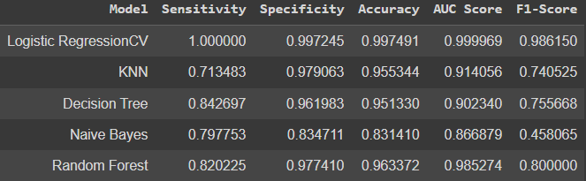
The performance of the selected 5 models (logistic regression, kNN, Decision tree, Naïve Bayes, Random forest) are compared using various performance metrics

Slide 30
coNCLUSION
Among all the models evaluated, Logistic Regression model perform best in predicting diabetes using health related parameters, with high accuracy rates, sensitivity, specificity, AUC score, and F1-score

Slide 31

THANK YOU

